Slide 1
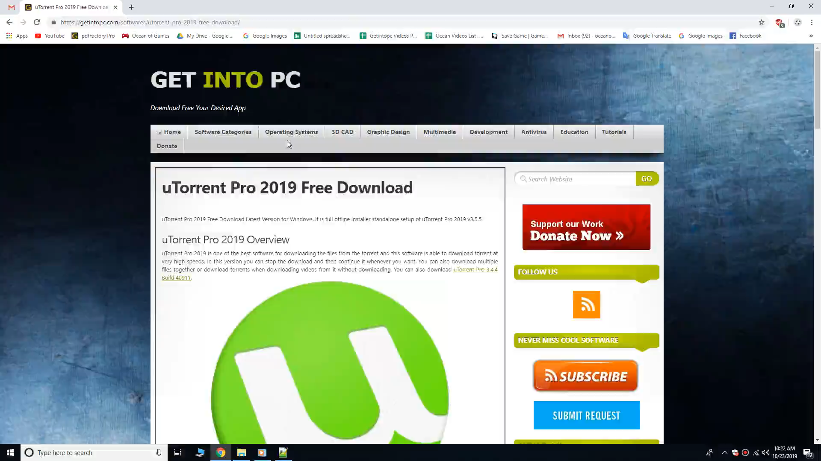

Slide 2
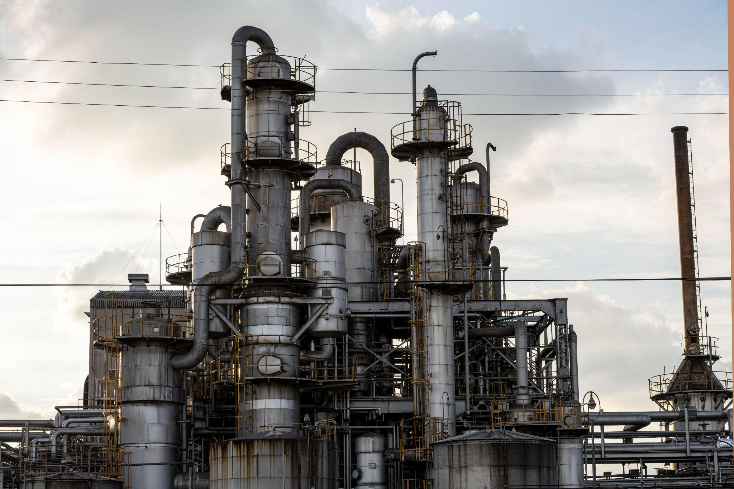
Harbor & Port Industry Company Profile
Here is where your presentation begins

Slide 3
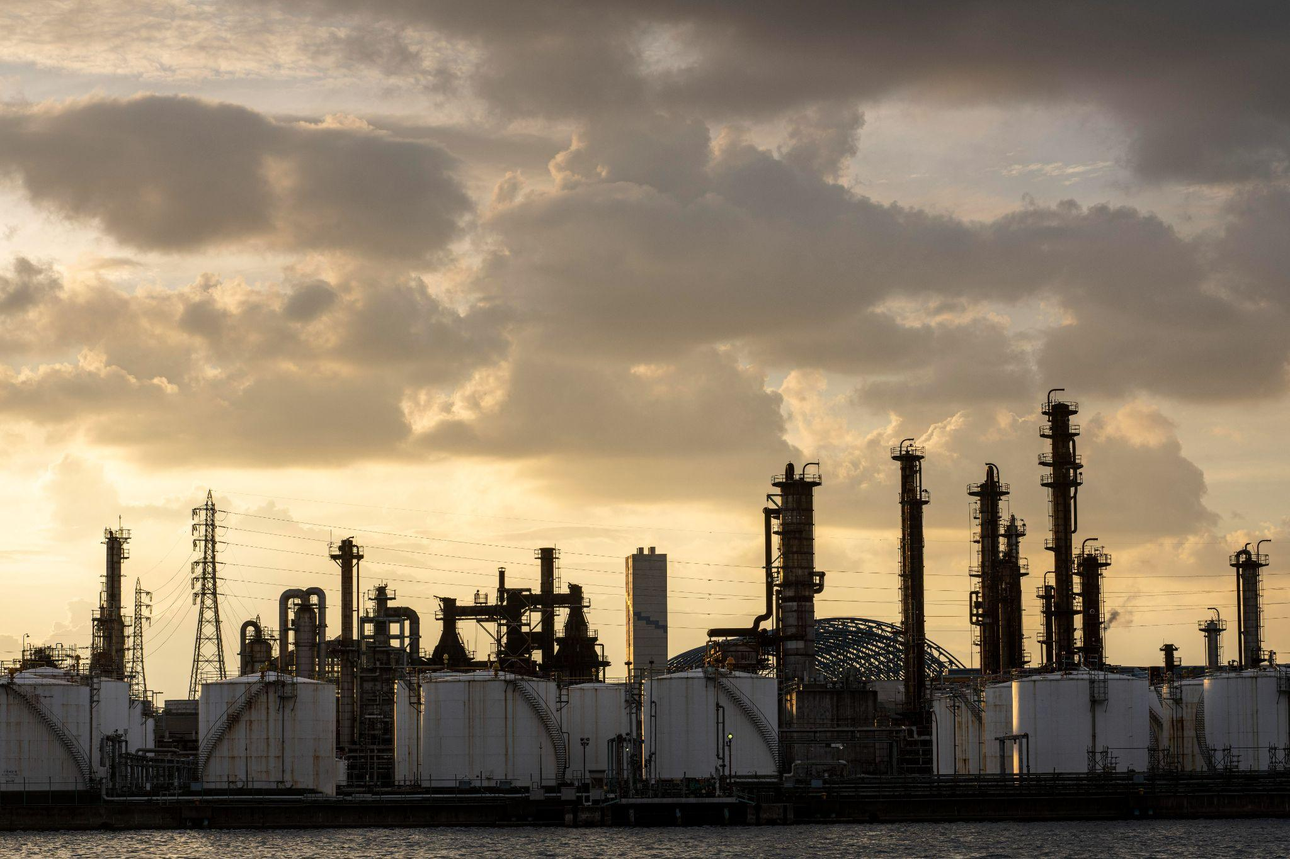
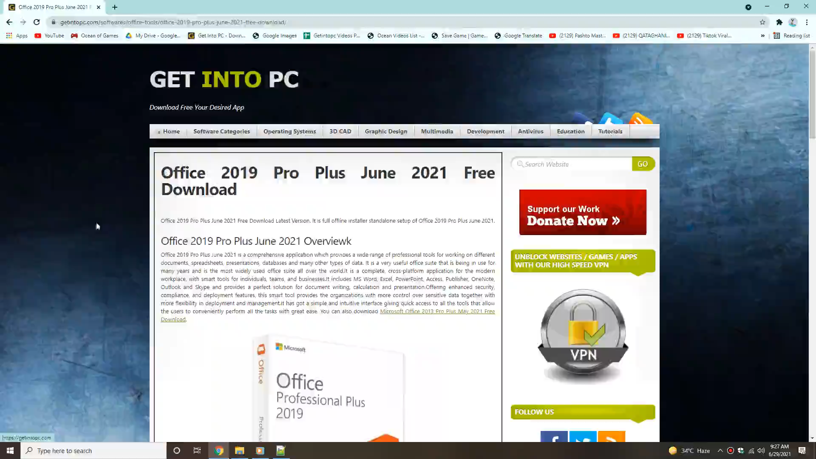
01
Introduction

Slide 4
Four ideas
Mars
Venus
Despite being red, Mars is actually a cold place. It’s full of iron oxide dust, which gives the planet its reddish cast, and it’s made of basalt
Venus has a beautiful name and is the second planet from the Sun. It’s terribly hot, even hotter than Mercury, and has a very poisonous atmosphere
Jupiter
Saturn
Jupiter is a gas giant and the biggest planet in the Solar System. It’s the fourth-brightest object in the night sky and was named after a Roman god
Saturn is a gas giant and has several rings. It’s composed mostly of hydrogen and helium. It’s the sixth planet from the Sun

Slide 5
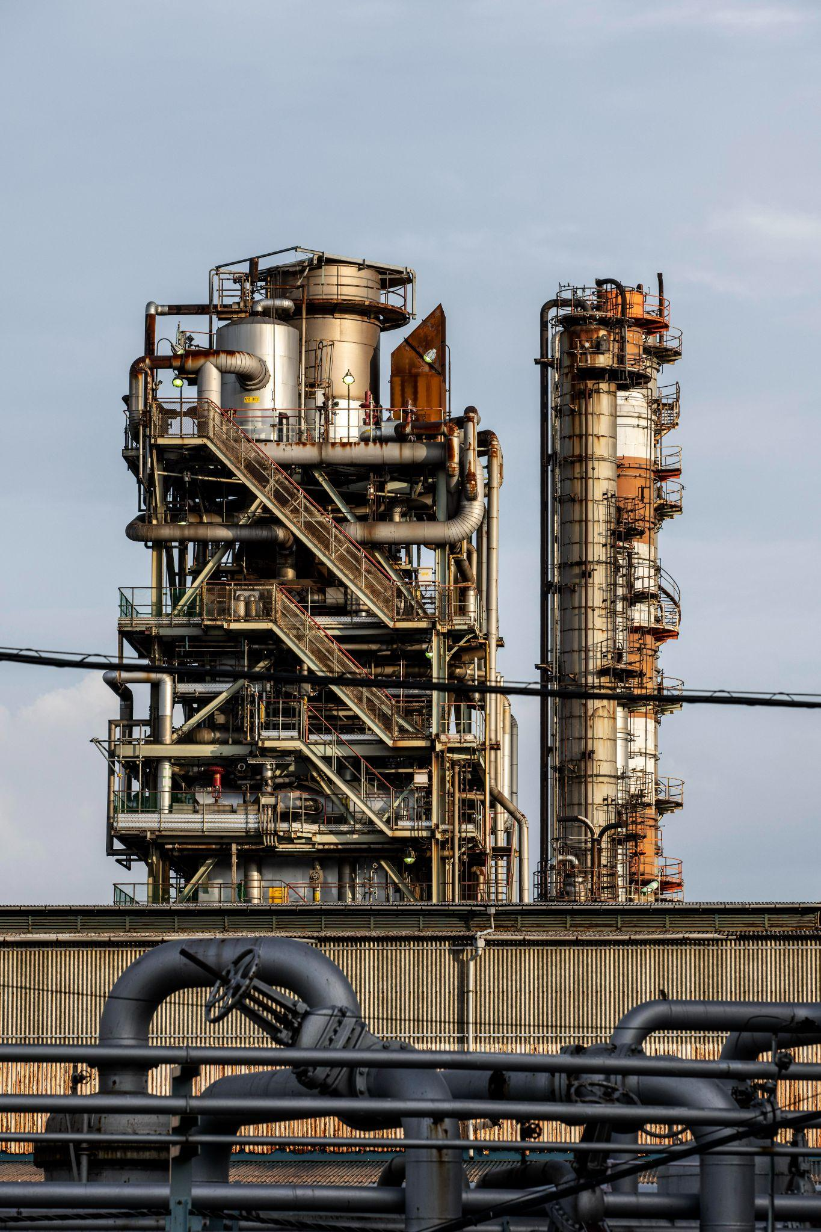
4,498 M
Big numbers catch your audience’s attention

Slide 6
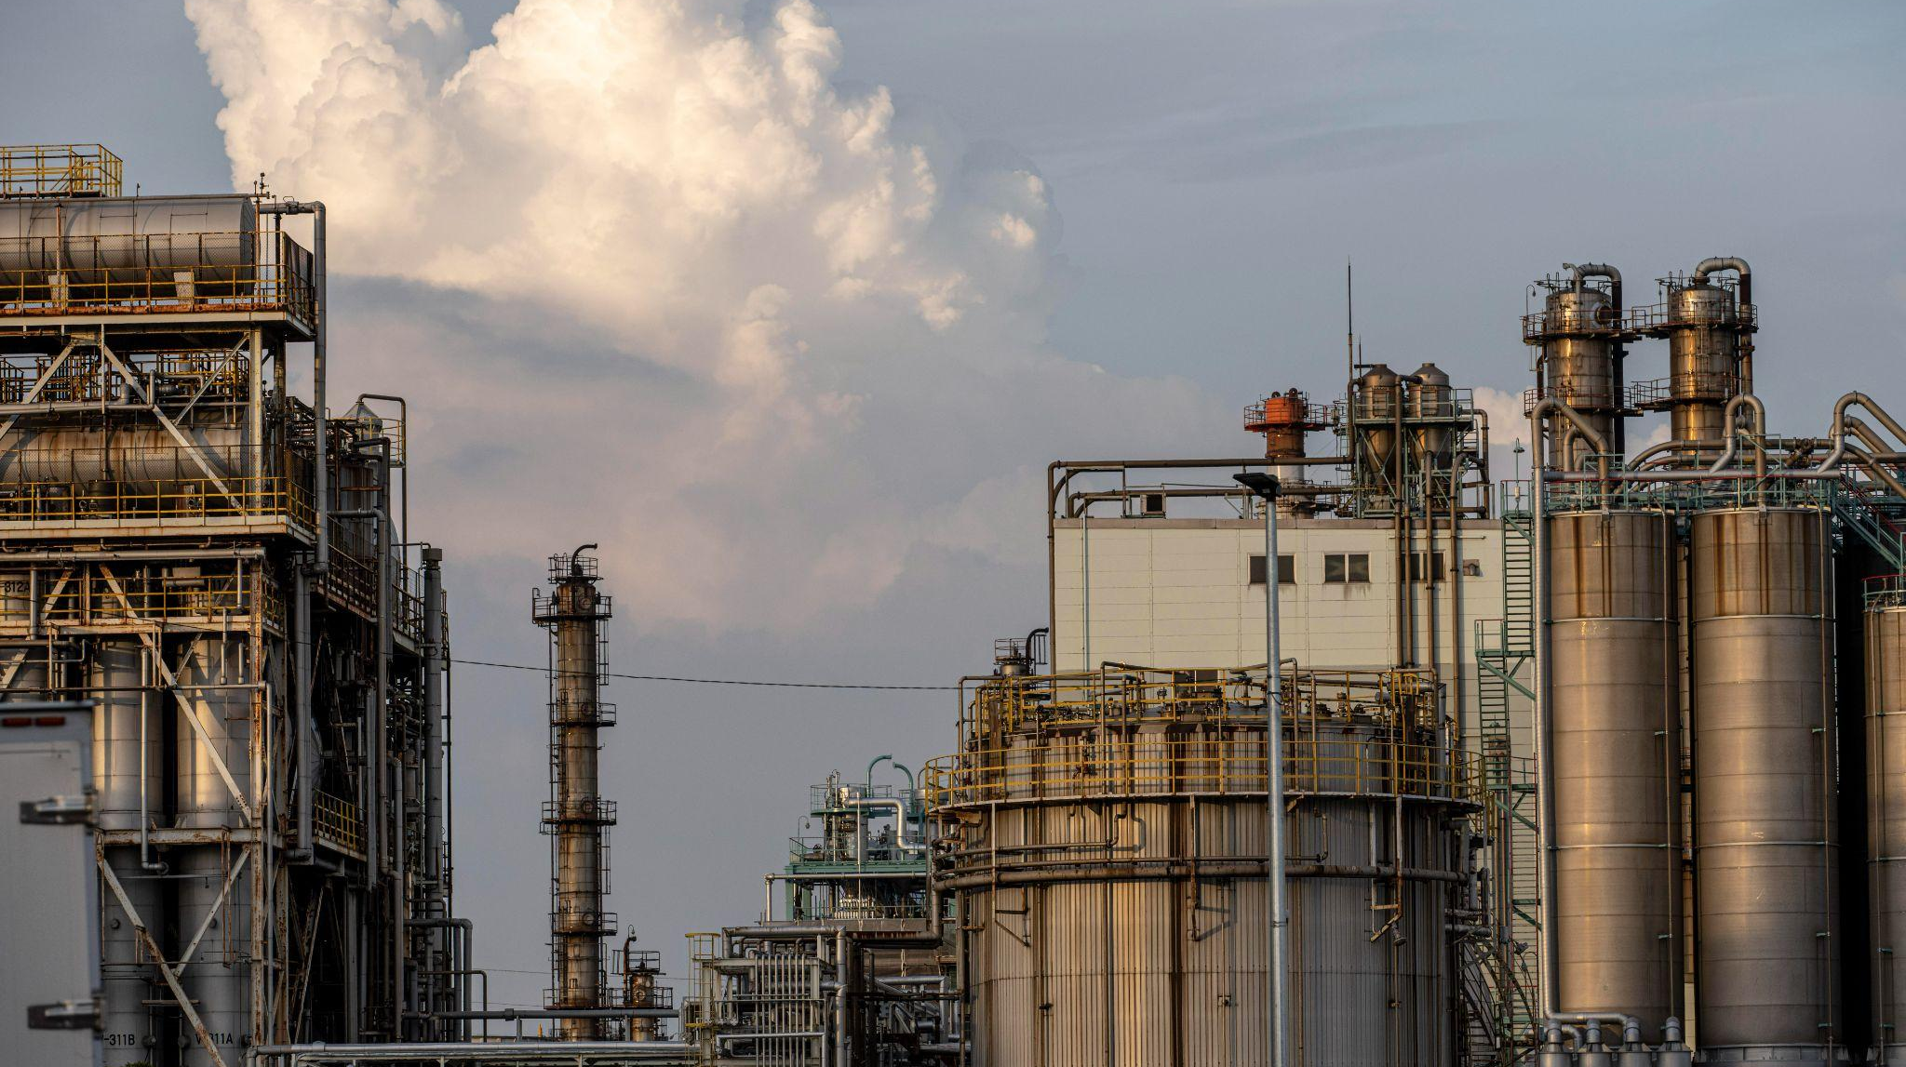
A picture is worth
a thousand words

